Slide 1
David C. Frost
Retired Director of Logistics
Medina

Slide 2
Based on the outcome of RIO+20
“The Future We Want”
July 9, 2013
The UN General Assembly established a new High-level Political Forum, which will replace the UN Commission on Sustainable Development.
Provide political leadership, guidance and recommendations for sustainable development;
Review progress in the implementation of related commitments;
Enhance integration of the three dimensions of sustainable development – economic, social and environment.”
end extreme poverty in this generation
narrow the global gap between rich and poor
without inflicting irreparable damage to the environmental basis for our survival
http://www.un.org/apps/news/story.asp?NewsID=45376&Cr=sustainable+development&Cr1

Slide 3
The Obama administration announced the
results of a $1 million study calling for installing sustainability in the culture of government.
“It is also necessary to maintain long-term initiatives on sustainability despite periodic temporal change in leaders (and changes in the beliefs and priorities of the leadership)”
“One of the most significant challenges to governance linkages …is that government agencies at all levels - federal, state, local, tribal and even international - can only do what they have been authorized to do by their governing authorities—namely, Congress, state legislatures, etc.”
June 28, 2013
The study suggests the President could use
Executive Order authority to implement the plan
http://sites.nationalacademies.org/pga/sustainability/index.htm

Slide 4
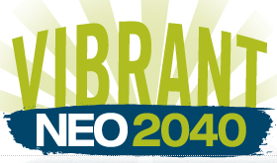
What is
all about?
“NEOSCC’s mission is to create conditions for a more
VIBRANT, RESILIENT, and SUSTAINABLE Northeast Ohio”
…for a 12-county planning area comprised of Ashtabula,
Cuyahoga, Geauga, Lake, Lorain, Mahoning, Medina,
Portage, Summit, Stark, Trumbull and Wayne counties.
http://vibrantneo.org/neoscc/history/

Slide 5
VIBRANTNEO IS A LOCAL INITIATIVE.
“NEOSCC is made up of local governments, agencies, and organizations from across Northeast Ohio… All decisions to accept, pursue and implement VibrantNEO 2040 will need to be made at the local level….”
Some will say it’s “bottom up”
but there’s common language all
over the United States….
“Vibrant, resilient, smart growth,
complete streets”
http://vibrantneo.org/blog/
Mid-Hudson
OH-KY-IN
Knoxville RTPO
Plan E TN
Metro Oregon
Destination Erie
Chicago Metro Agency
Granite State
Gulfport Regional
Bear Lake Valley UT
Thunder Valley SD
Metro Area Boston
Finger Lakes
South Florida Regional
South East Council MI
Capital Region Hartford
Des Moines Area Metro

Slide 6
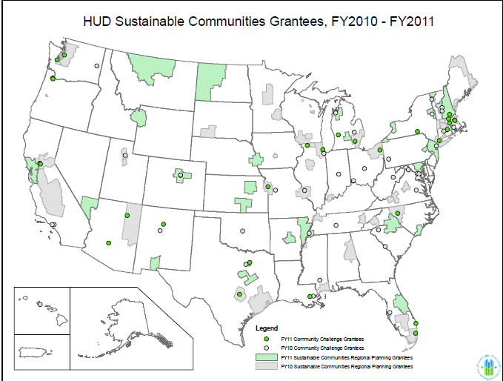
NEOSCC

Slide 7
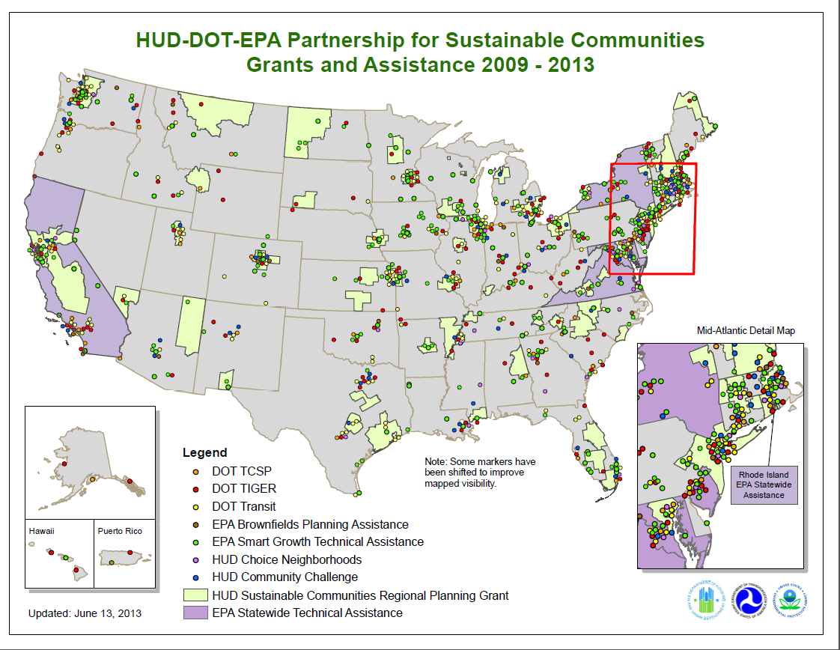

Slide 8
PARTICIPATION IN VIBRANTNEO 2040 IS A CHOICE.
“While local government has been and will continue to be
crucial to the development and implementation of
VibrantNEO 2040, there is nothing about the VibrantNEO
2040 process that would force a local government to
participate or change.
Every local government, organization and individual
participating in creating VibrantNEO 2040
is doing so by choice.”

Slide 9
VIBRANTNEO 2040 WILL HAVE NO EFFECT ON
MUNICIPAL BOUNDARIES.
“VibrantNEO 2040 is being designed to protect and preserve the things we value most about Northeast Ohio and one of those things is our local communities, with their rich histories and commitment to self-determination. Many of these communities have participated in NEOSCC since its inception; VibrantNEO 2040 will be a tool to strengthen local governments, not undermine them.”
http://vibrantneo.org/vibrantneo-2040/initiative-goals/

Slide 10
“Regionalism under the Commissioner’s definition…..”
“All Encompassing Regional Government –
A single government covering multiple units and
levels of government.”
Former Cuyahoga County Commissioner
Peter Lawson Jones
NOACA Action Plan for a Livable Region
Connections 2030
http://www.noaca.org/connect2030.html

Slide 11
VIBRANTNEO 2040 DOES NOT ADDRESS ISSUES OF
REVENUE AND TAXATION.
“While VibrantNEO 2040 will make recommendations
about where financial resources may be deployed…….
how local governments generate financial resources
is well beyond its scope and is a matter left to local
governments and residents to decide.”

Slide 12
There are several organizations that have expressed
an interest in revenue sharing, including:
Building One America
First Suburbs Consortium
Regional Prosperity Initiative
Fund for our Economic Future
https://buildingoneamerica.org/
http://www.firstsuburbs.org
http://www.neo-rpi-org/
http://www.futurefundneo.org/

Slide 13
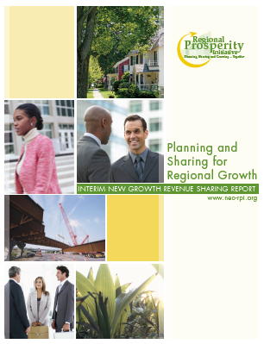
Regional Prosperity Initiative
RPI has advanced a substantial conversation
regarding regional and collaborative principles.
RPI has focused on the two core areas:
1) regional strategic infrastructure planning, and
2) the development of a regional economic development alliance with the possibility of resource sharing to support appropriate collaboration.
Mike Lyons and Bill Currin from RPI are
on the NEOSCC Board of Directors
http://www.neo-rpi.org/site.cfm/Share.cfm

Slide 14
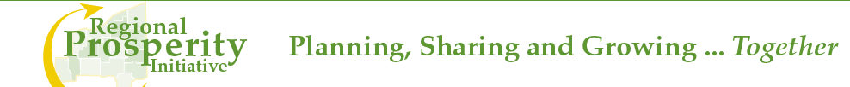
Commercial & Industrial (C&I) Property Tax • – 60% Retained / 40% Pooled
Income Tax (by those jurisdictions leveraging an income tax) – 80% Retained • / 20% Pooled
Inflationary Adjustment • – All new growth (C&I, Income) tax base sharing will be subject to a CPI (i.e. 3%) deduction
Twelve county initial implementation, with the development of a trigger • mechanism to add counties (4) later
http://www.neo-rpi.org/site.cfm/Share.cfm

Slide 15
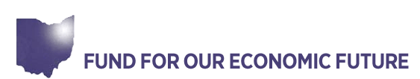
Reducing Government Fragmentation and Inefficiency
“When regions have too many governments, it becomes
difficult for them to work together and pursue regional
goals. “
Reducing Sprawl and Improving Regional Connectivity
“Northeast Ohio must reduce the negative impacts of
sprawl…Northeast Ohio is threatened by the movement of
people and businesses out of the region’s cities…”
Brad Whitehead and John Mitterholzer
are on the NEOSCC Board of Directors
The Fund is a major source of funding for NEOSCC
www.voiceschoices.org

Slide 16
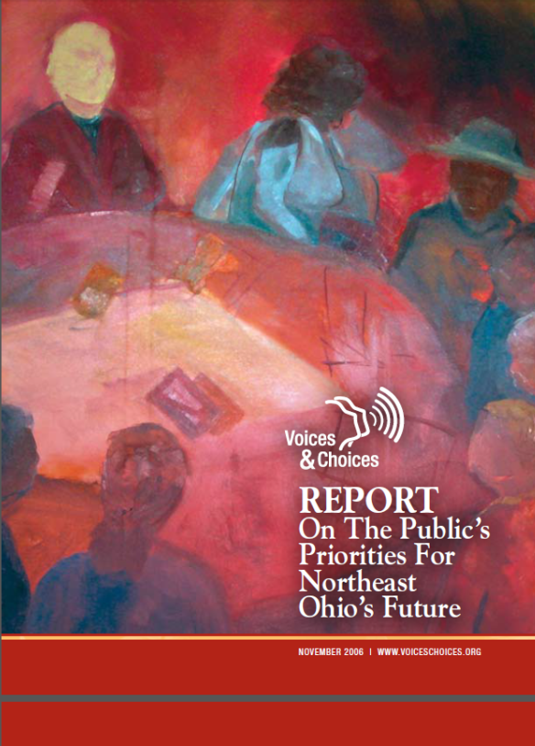
The Voices & Choices report was scrubbed
from the internet a few days after I
downloaded it.
Went back to see why….this quote may
be a reason……
“Create a regional organization that will research the best
opportunities for consolidating or reorganizing local
governments in Northeast Ohio, and mobilize support for
its recommendations.” p. 17
http://web.archive.org/web/20070718180033/http://www.voiceschoices.org/node/194

Slide 17
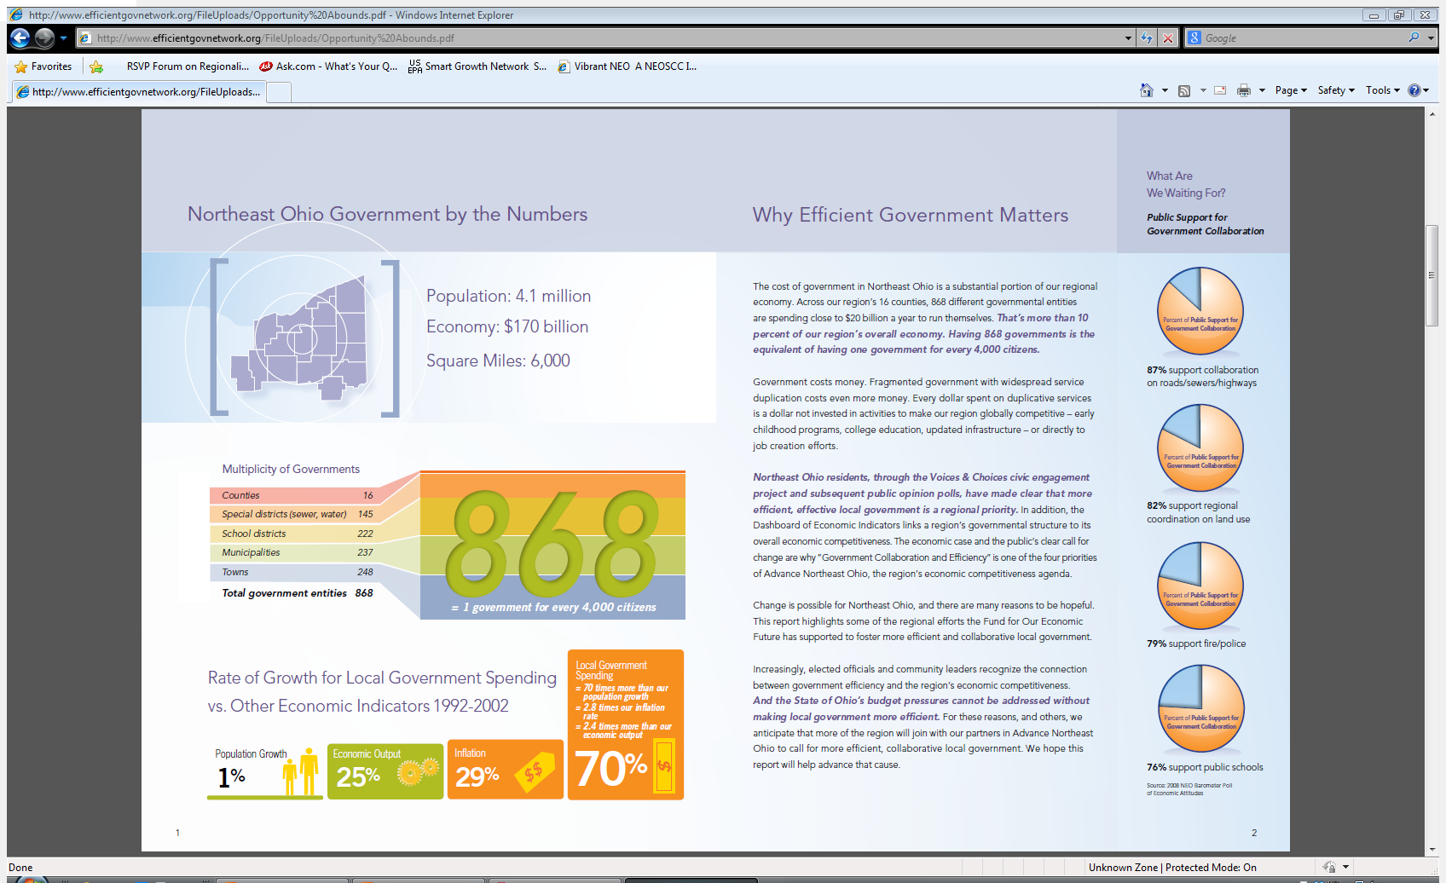
Publication of Fund for
Our Economic Future
4.1 million/501
1 government for
Every 8183 citizens
http://www.efficientgovnetwork.org/FileUploads/Opportunity%20Abounds.pdf

Slide 18
VIBRANTNEO 2040 RESPECTS AND WILL PROTECT THE RIGHTS OF PROPERTY OWNERS
“Planning, when done correctly, protects the rights of property owners by helping to ensure land is put to its highest and best use……..”
Goal 3: Respect Choice
“Preserving our quality of life, expanding choices for
Northeast Ohio’s citizens and respecting local government
and individual property rights are essential principles
for this process.”
http://vibrantneo.org/vibrantneo-2040/initiative-goals/

Slide 19
VIBRANTNEO 2040 RESPECTS AND WILL PROTECT THE RIGHTS OF PROPERTY OWNERS
There are no specific details about how NEOSCC
proposes to protect private property.
“The Environments work stream….. includes tasks such
as reducing availability of undeveloped land while
simultaneously facilitating compact, infill, mixed-use,
and walkable development.”
http://vibrantneo.org/vibrantneo-2040/workstreams/

Slide 20
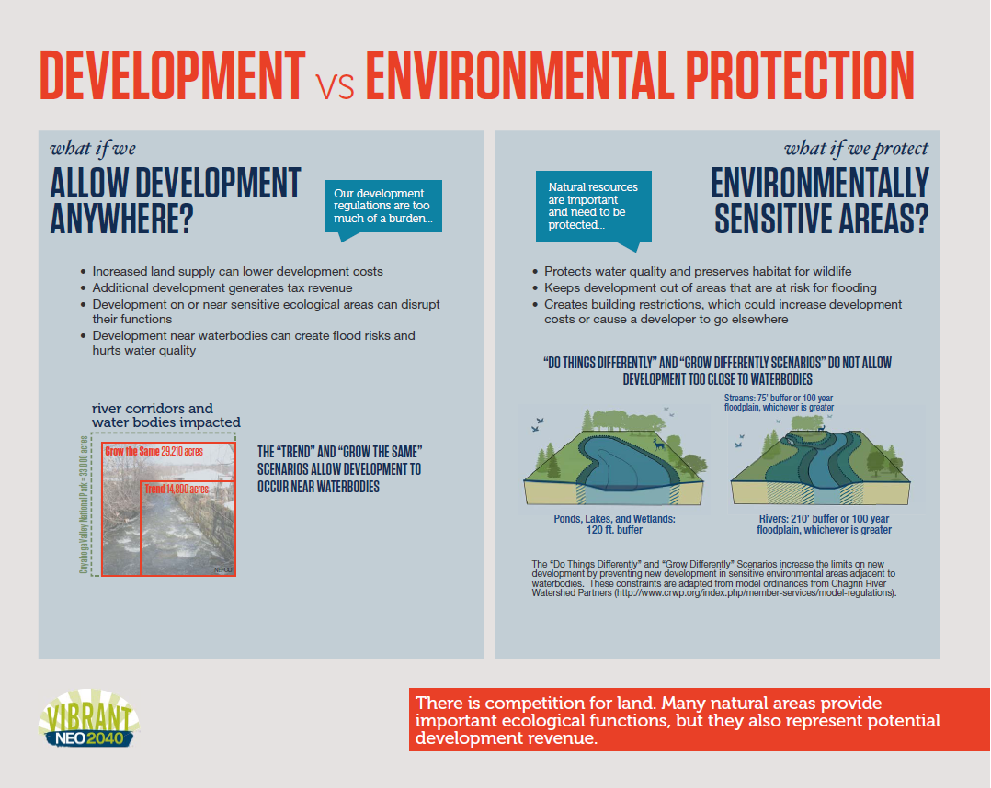
Redundant?
Most jurisdictions already have
regulations regarding wetlands, setbacks,
floodplains, etc.
Federal and State EPA regulations apply, too.

Slide 21
Government “owns” about 28% and wants more
Wetlands
Endangered Species Act
Clean Water Initiative
Blueways (500’ setback)
Greenways
Historic Districts
National Parks
National Monuments
Transfer of Development Rights
Heritage Areas
Scenic Highways
Scenic Rivers
Economic Development Zones
Roadless wilderness
Conservation easements
Military
Scenic rivers
Western Reserve Land Conservancy
Nature Conservancy
UNESCO World Heritage Areas (21)

Slide 22
The Wildlands Project
“We must make this place an insecure and
inhospitable place for Capitalists and their projects –
We must reclaim the roads and plowed lands,
halt dam construction, tear down existing dams,
free shackled rivers and return to wilderness
millions of tens of millions of acres of presently
settled land”
Dave Foreman Earth First

Slide 23
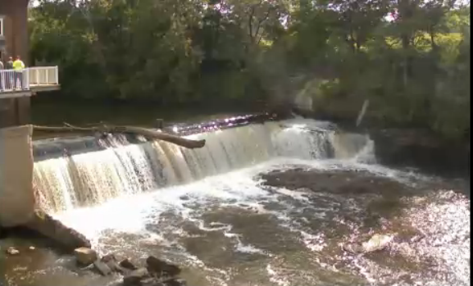

Slide 24
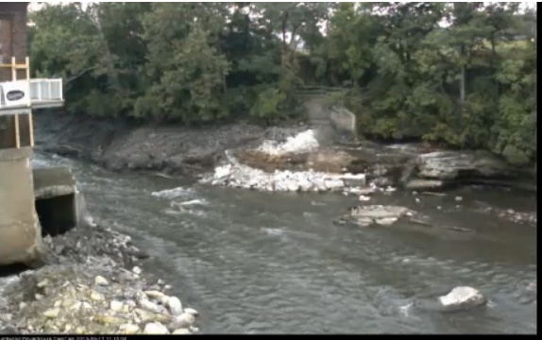

Slide 25
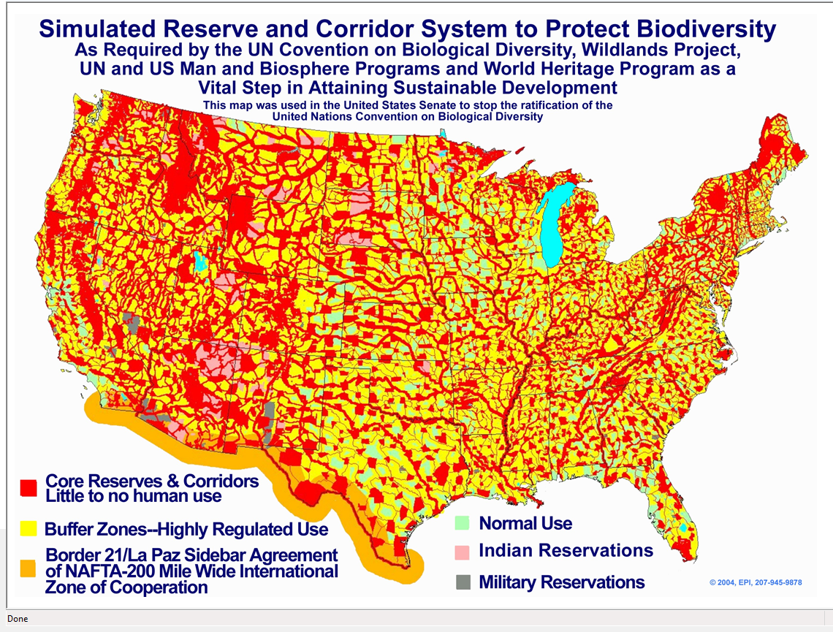

Slide 26
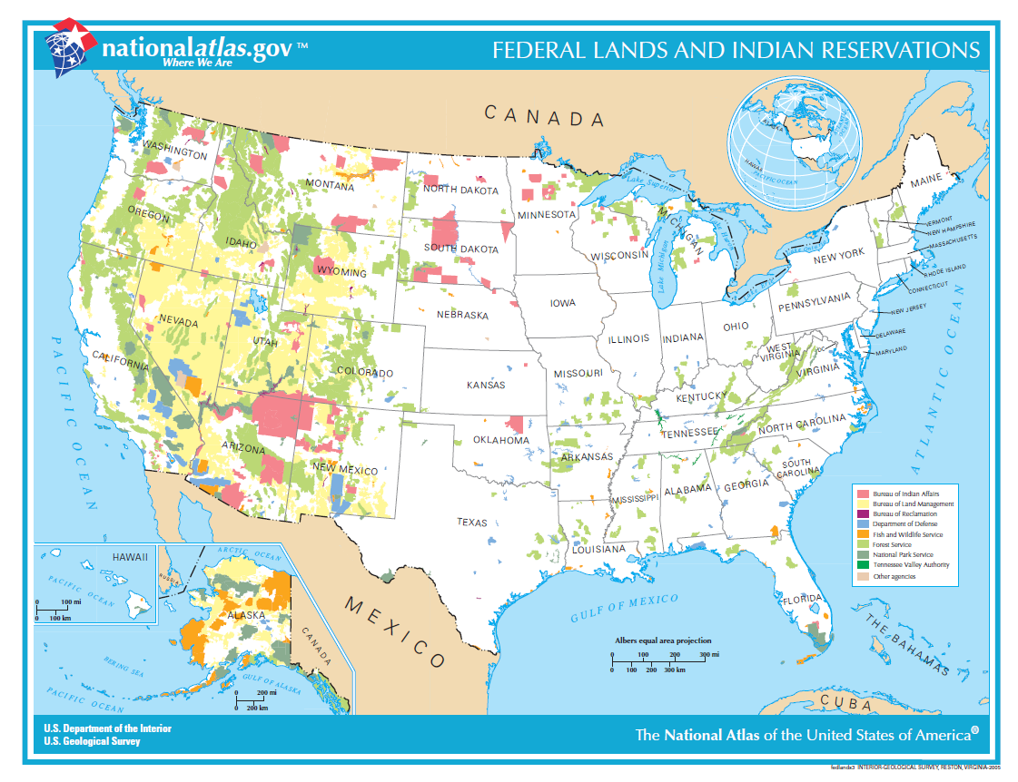
Lower 48 states 1.9 billion acres
Developed land - 66 million acres (3.5%)
“Sprawl”, subdivisions, farmhouses -
73 million acres (3.8%)
www.westernwatersheds.org
http://nationalatlas.gov/printable/images/pdf/fedlands/fedlands3.pdf

Slide 27
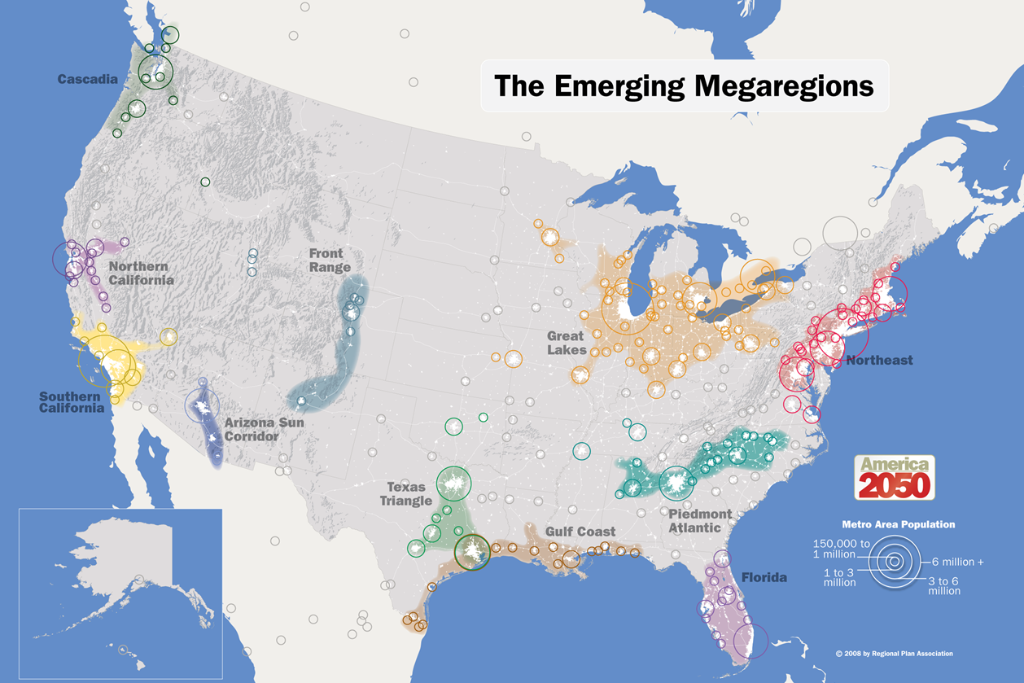
http://www.america2050.org/

Slide 28
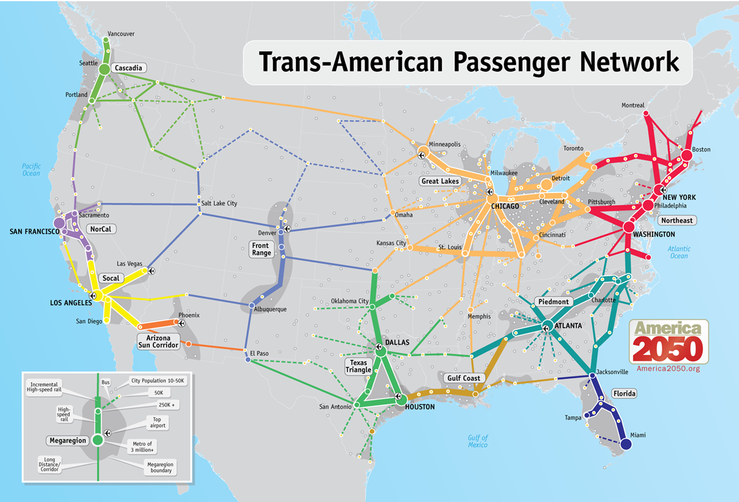
http://www.america2050.org/images/2050_Map_Passenger_Network_150.png

Slide 29
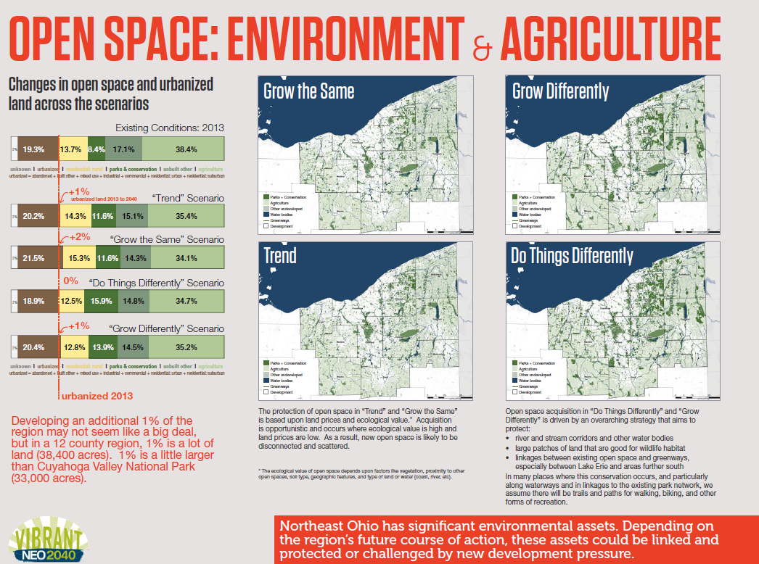
Open space acquisition in “Do Things Differently” and “Grow
Differently” is driven by an overarching strategy that aims to
protect:
River and stream corridors and other water bodies
Large patches of land that are good for wildlife habitat
Linkages between existing open space and greenways
especially between Lake Erie and areas further south
In many places where this conservation occurs, and particularly
along waterways and in linkages to the existing park network, we assume there will be trails and paths for walking, biking, and other forms of recreation.

Slide 30
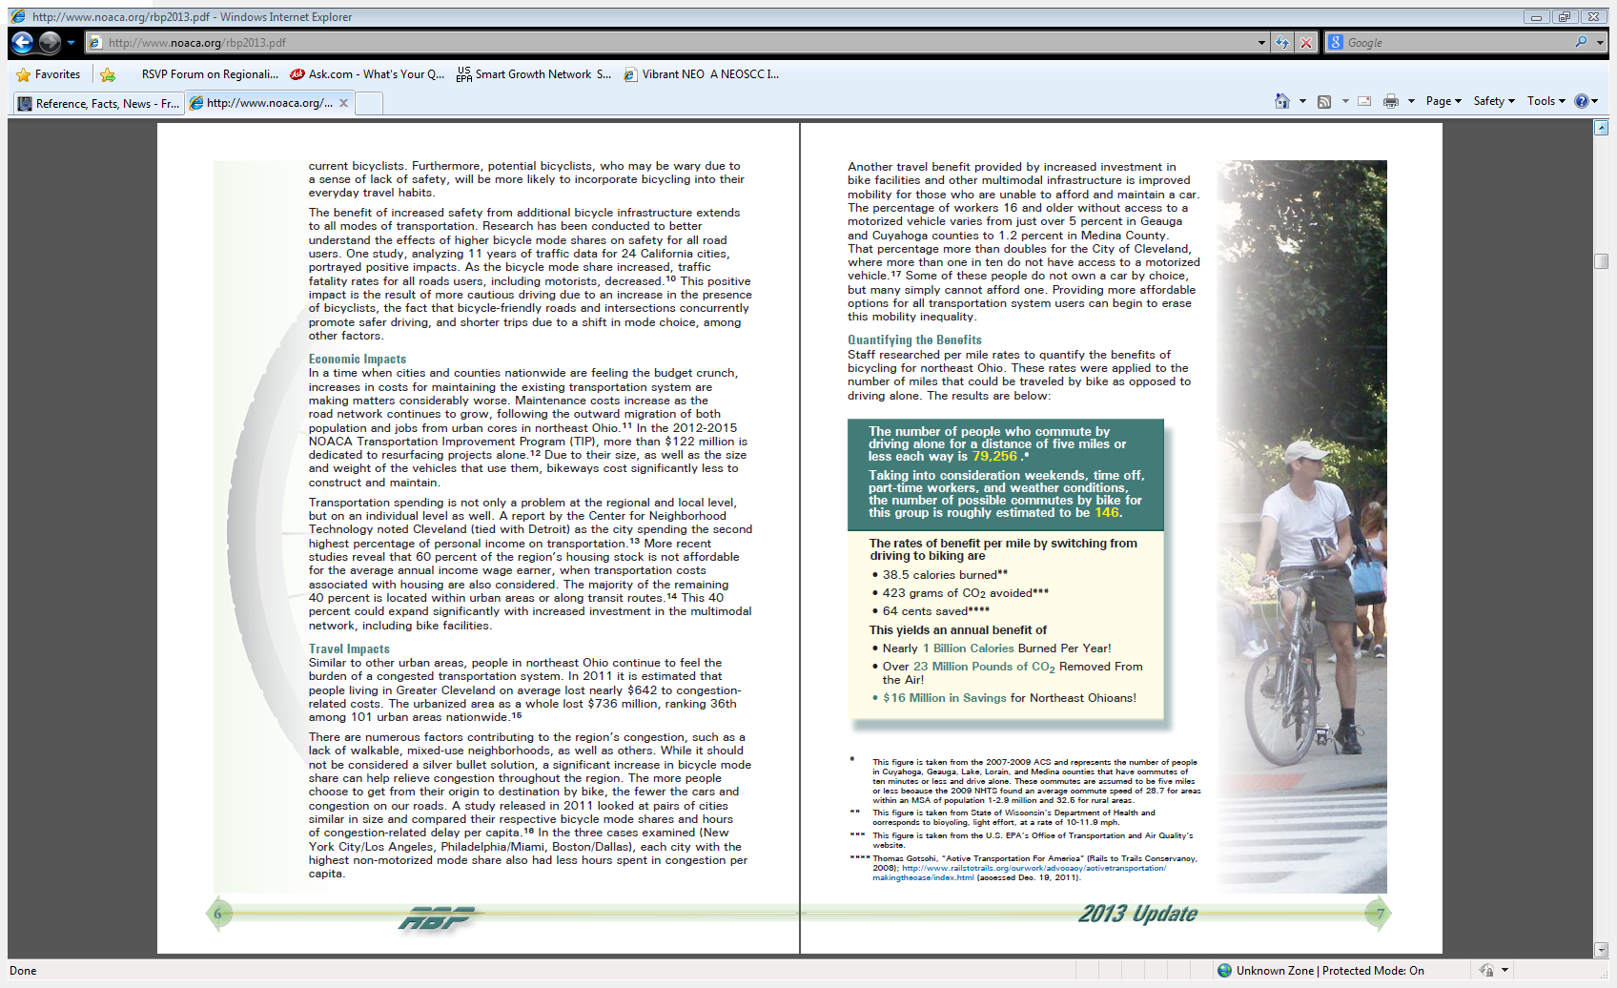
Bicycling
http://www.noaca.org/rbp2013.pdf

Slide 31
Bicycling
$136,600,000
http://www.noaca.org/rbp2013.pdf

Slide 32
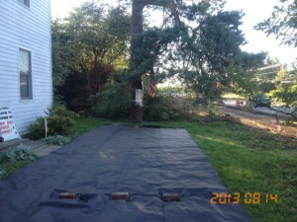
Home of Jennie Grenato in Montgomery County
Miami Valley Regional Planning Commission

Slide 33
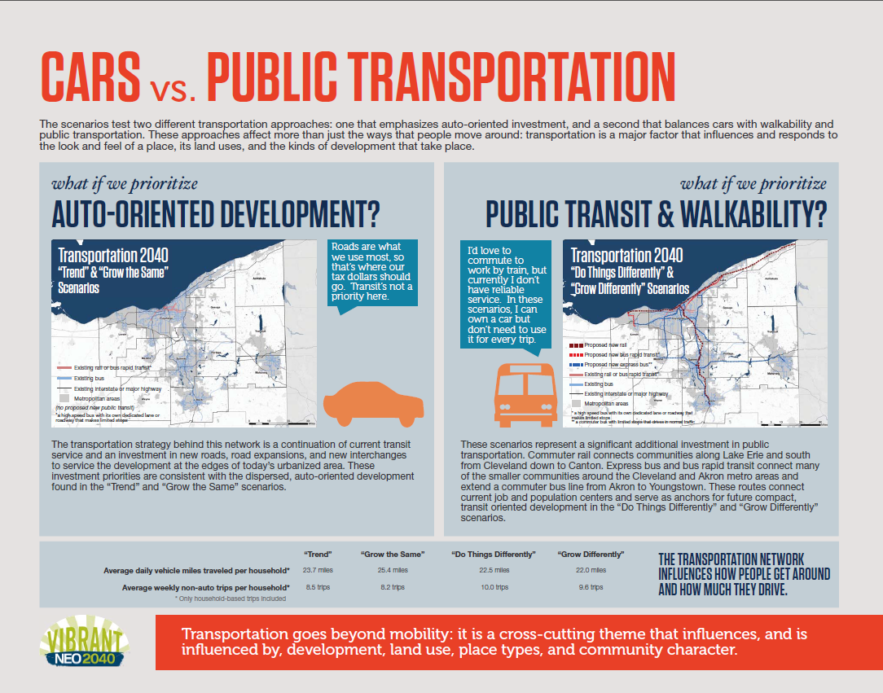
Avg. daily VMT | Miles/day | 6 days/wk | @ 25 mpg | @$3.75/gal
Trend | 23.7 | 7394 mi | 296 gal | $1109
Do things differently | 22.5 | 7020 mi | 281 gal | $1053

Slide 34
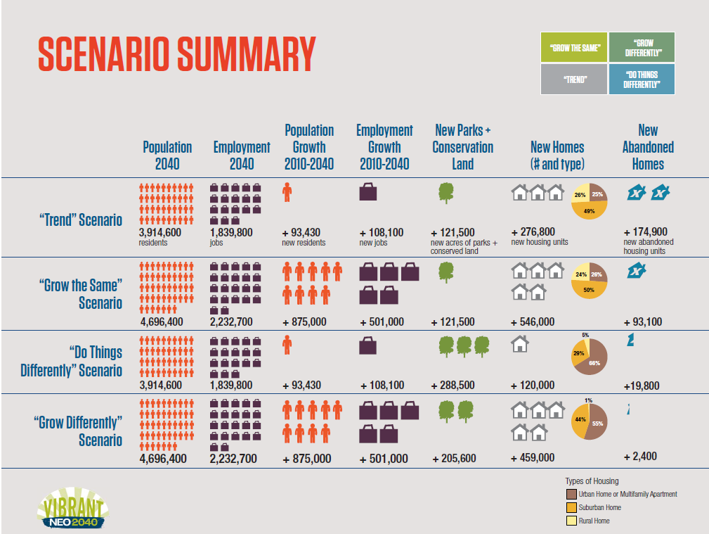
Trend Scenario vs Do Things Differently
156,800 fewer abandoned housing units
155,100 fewer new homes
Does that contemplate new residents will
live in what might have been abandoned?

Slide 35
Abandoned homes are likely the result of:
economy/jobs
abandonment by those who couldn’t
afford the mortgage
Those who are displaced because of this are
not likely to purchase another home, but
would probably find housing in a home or
apartment in an urban area.
This “fits in” with the goals of higher
density; smart growth

Slide 36
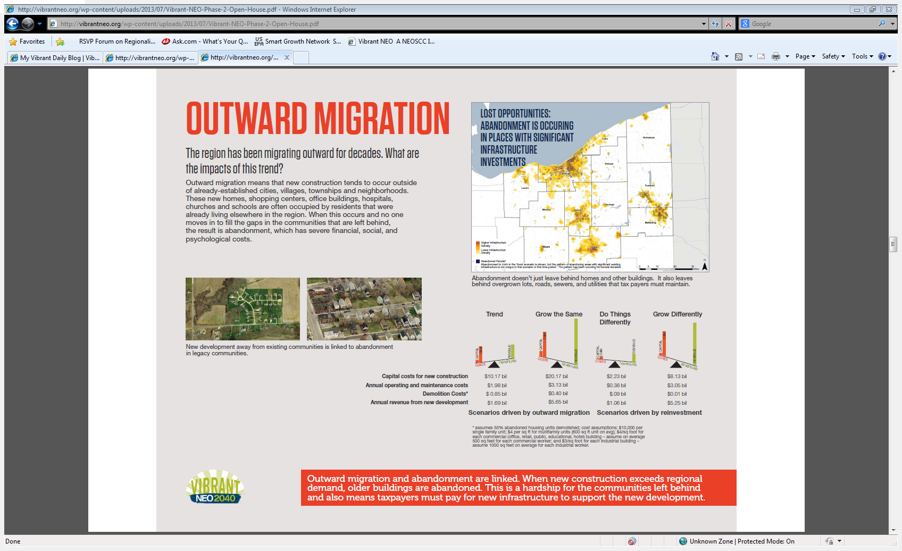
“These new homes….are often occupied by residents…
already living elsewhere in the region.…and no one
moves in to fill the gaps….the result is abandonment….”
What lender will finance those who abandon
their last property?

Slide 37
On Feb 1, 2011 representatives from NEOSCC and HUD
signed a cooperative agreement.
“Because this is a Cooperative Agreement, HUD intends
to have substantial involvement in the review,
development, and approval of all aspects of the work…
may include…Review and provide scientific and technical
recommendations on the final study report, including
final interpretation of study results. (Page 19)
The Grantee…certifies to HUD that it shall administer its
grant in a manner that affirmatively furthers fair housing..
(Page 18)

Slide 38
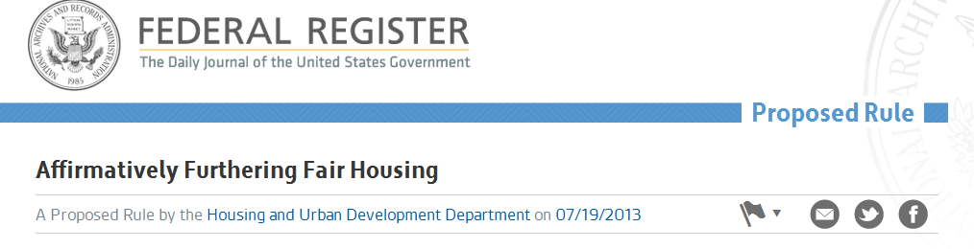
Gathering information at the census tract level
“Incorporating, explicitly, fair housing planning processes…
incorporates fair housing priorities and concerns more
effectively into housing, community development, land-
use…that influence how communities and regions grow….”
https://www.federalregister.gov/articles/2013/07/19/2013-16751/
affirmatively-furthering-fair-housing

Slide 39
HOW WILL THIS PROJECT BE SUSTAINED
ONCE NEOSCC GOES AWAY?
“Sustaining VibrantNEO 2040 beyond the organizational life of NEOSCC will be the responsibility of the NEOSCC Board and the Northeast Ohioans who support the continued effort for a more vibrant, resilient and sustainable region.”
Perhaps clues can be found in recent actions
take by the NOACA Board of Directors
http://vibrantneo.org/wp-content/uploads/2012/09/NEOSCC_VNEO_FAQ_070513.pdf

Slide 40
Resolution No. 2013-020
June 6, 2013 NOACA Board of Directors entered into a
contract with Parsons Brinckerhoff, Inc. in an amount
not to exceed $109,231.
Proposed scope of services:
Visioning; public meetings, open houses, surveys….
Plan Development
Conduct inventory of regional resources:
“…finances, people, health, education, business
and job opportunities, housing, art and culture,
leisure, recreation and entertainment and
geography.”
The Request for Proposals was posted at
www://noaca.org/RegionalStrategicPlanRFP.pdf
It’s been removed from the internet.
“A strategic plan is a ‘living document’…”

Slide 41
Transportation Livability Communities Initiative
Consultants shall assemble a project team and work
with TLCI sponsors & NOACA to develop a scope of
services consistent with NOACA’s long-range
transportation goals and the TLCI objectives
Transportation & land-use plans
Complete streets; bicycle & pedestrian network
Transit oriented development (TOD)
Placed-based reinvestment in underutilized
or vacant properties
Environmental justice
Collaboration between regional & community partners
http://noaca.org/tlcirfq2014.pdf

Slide 42
MPOs…that receive FTA planning funds are expected
to incorporate Livable Communities elements into
their regular planning work programs.
Property acquisition, restoration or demolition
Purchase buses; enhancements to transit stations
Lighting, surveillance, community police, security
Sidewalks, aerial walkways, kiss & ride facilities
Transit marketing & pass programs
Elements include applicable zoning and land use policies
such as higher density considerations, mixed use
guidelines, parking management, and pedestrian/
bicycle transit oriented design standards.
http://www.fhwa.dot.gov/publications/publicroads/00mayjun/liability.cfm
http://ntl.bts.gov/DOCS/livbro.html

Slide 43
We must decide if we are comfortable with
greater influence on our local governments,
our way of life, our future, as proposed by:
Federal agencies – HUD, EPA, DOT, USDA,+
MPOs like NOACA, Eastgate, SCATS, NEFCO
NEOSCC or it’s replacement
Special interests, NGOs, foundations
Tell your elected officials and legislators
what you want.
Educate your friends and neighbors.
It’s about
The Future You Want

Slide 44
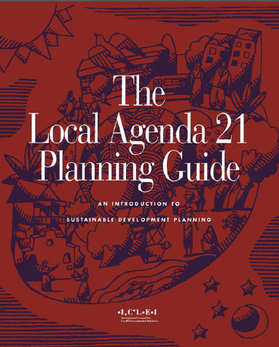
Local Governments for Sustainability
ICLEI USA/ICLEI Global*
ICLEI helped write Chapter 28 of Agenda 21
Local Authorities’ Initiatives in Support of
Agenda 21.
The Local Agenda 21 Planning Guide has
been prepared to assist local governments
and their local partners to learn and undertake the challenging task of sustainable development planning.
The Guide offers tested and practical advice
on how local governments can implement the
United Nations‘ Agenda 21 action plan for
sustainable development and the related
United Nations’ Habitat Agenda.
Akron
Cleveland
Alliance
Oberlin
Youngstown
(pay dues)
“I’m from the government (UN)
and I’m here to help you.”
http://www.iclei.org/
http://www.un-documents.net/a21-28.htm
* International Council on Local Environmental Initiatives

Slide 45
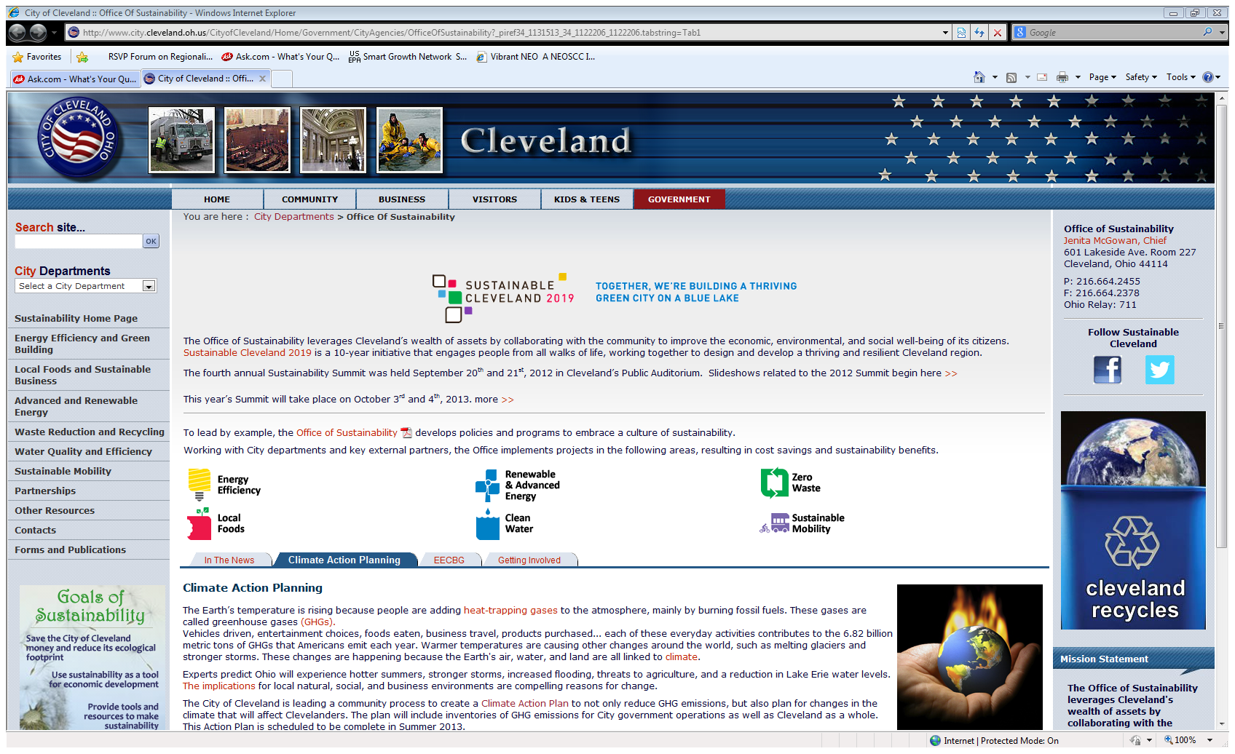
Cleveland Climate Action Plan
“The Earth’s temperature is rising because people
are adding heat-trapping gases to the atmosphere
mainly by burning fossil fuels.”
http://www.sustainablecleveland.org/wp-content/uploads/2013/07/
Cleveland-Climate-Action-Plan-DRAFT-7.3.13.pdf

Slide 46
NOACA is the metropolitan planning organization (MPO) (that) works
with other organizations to help address northeast Ohio’s
transportation, air quality, and water quality needs.
Transportation Livability Communities Initiative
NOACA is prequalifying consultants for TLCI planning contracts
Possible TLCI efforts include:
• Transportation and land‐use plans for redevelopment
• Bicycle and pedestrian network/complete streets implementation
plans
• Transit‐oriented development plans
• Neighborhood traffic calming plans, including improvements for
bicycle and pedestrian safety and accessibility
• Economic development plans based on transportation investments
http://noaca.org/tlcirfq2014.pdf
http://www.fhwa.dot.gov/publications/publicroads/00mayjun/liability.cfm

Slide 47
Lead consultants shall assemble a project team and work
with TLCI sponsors and NOACA to develop a scope of
services consistent with NOACA’s long-range transportation
goals and the TLCI objectives
Develop transportation projects that provide more travel options through complete streets and context sensitive solutions, increasing user safety and supporting positive public health impacts
Promote reinvestment in underutilized or vacant/ abandoned properties through development concepts supported by multimodal transportation systems

Slide 48
Support economic development through place-based transportation and land use recommendations, and connect these proposals with existing assets and investments
Integrate accessibility and environmental justice into preferred recommendations
Complement existing plans and proposed initiatives, and encourage collaboration between regional and community partners
Engage citizens and communities through innovative public engagement and inclusive planning
http://noaca.org/tlcirfq2014.pdf

Slide 49
Metropolitan and other planning organizations that receive FTA planning funds are expected to incorporate Livable Communities elements into their regular planning work programs. Eligible capital activities or capital project enhancements of demonstration projects include:
Property acquisition, restoration or demolition of existing
structures, site preparation, utilities, building foundations,
walkways, and open space that are physically and functionally
related to mass transit facilities
The purchase of buses, enhancements to transit stations, park
and ride lots and transfer facilities incorporating community
services such as day care, health care and services

Slide 50
3. Safety elements such as lighting, surveillance and
community police and security services
Site design improvements including sidewalks, aerial
walkways and bus access and kiss and ride facilities
Operational enhancements such as transit marketing and
pass programs, customer information services, and
advanced vehicle locating, dispatch and information
services
Elements include applicable zoning and land use policies such as
higher density considerations, mixed use guidelines, parking
management, and pedestrian/bicycle transit oriented design
standards
http://ntl.bts.gov/DOCS/livbro.html

