Slide 1
Forum Committee
Loisirene Blumberg • Independence
David Frost • Medina
Patty Gascoyne-Telischak • Parma
Beverly A. Goldstein • Beachwood
Kirsten Hill • Amherst

Slide 2
We, the People, no longer control the
government through the Constitution.
We, the People, are controlled through
“regulation” by the government.

Slide 3
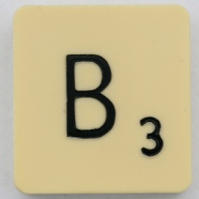










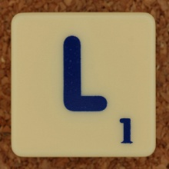


Define the takeover of
Private Property Rights

Slide 4
The following slides are an effort to
“connect the dots” in order to address comments
and concerns about the so-called conspiracy
regarding the UN program called Agenda 21 and
central planning efforts being promoted by
unelected bureaucrats, non-governmental
organizations, federal, state and local governments
in the United States.
Included are documents, relevant quotes and
sources. It begins in 1976 in Vancouver, CAN at
an event known as Habitat I.

Slide 5
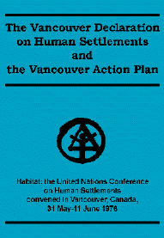
1976
Vancouver Declaration on Human Settlements
“Private land ownership is also a principal
instrument of accumulation and
concentration of wealth and therefore
contributes to social injustice….”
“Land is one of the fundamental elements
in human settlements. Every State has the right to take the
necessary steps to maintain under public control the use,
possession, disposal and reservation of land.”
“Public control of land use is therefore indispensable…..”
http://www.unhabitat.org/downloads/docs/924_21239_The_Vancouver_Declaration.pdf

Slide 6
Vancouver Declaration on Human Settlements
1976
10. Land is one of the fundamental elements in human settlements. Every State has the right to take the necessary steps to maintain under public control the use, possession, disposal and reservation of land. Every State has the right to plan and regulate use of land, which is one of its most important resources, in such a way that the growth of population centres both urban and rural are based on a comprehensive land use plan. Such measures must assure the attainment of basic goals of social and economic reform for every country, in conformity with its national and land tenure system and legislation.
http://habitat.igc.org/vancouver/van-decl.htm

Slide 7
1976
Control of land use changes
Direct intervention, e.g. the creation of land reserves and land banks, purchase, compensated expropriation and/or pre-emption, acquisition of development rights, conditioned leasing of public and communal land, formation of public and mixed development enterprises….
Recapturing plus value
The unearned increment resulting from the rise in land
values resulting from change in use of land, from public
investment or decision due to the general growth of the
community must be subject to appropriate recapture by
public bodies (the community)….
http://www.unhabitat.org/downloads/docs/924_21239_The_Vancouver_Declaration.pdf

Slide 8
When the World Commission on Environment and Development (Brundtland Commission) published its report in 1987, it presented a new concept - sustainable development. The concept became one of the most successful approaches to be introduced in many years. In fact, it helped to shape the international agenda and the international community's attitude towards economic, social and environmental development.
Their document was Our Common Future.
Note the presence of one Maurice Strong.
http://www.unece.org/oes/nutshell/2004-2005/focus_sustainable_development.html

Slide 9

The Brundtland Commission
1987
“Sustainable development is development
that meets the needs of the present
without compromising the ability of future
generations to meet their own needs.”
Chair: Gro Brundtland Vice Chair World Socialist Party
Commission members included Maurice Strong
http://www.un-documents.net/wced-ocf.htm

Slide 10
Another non-governmental organization
that helped write Agenda 21 in 1992 is
ICLEI, known as Local Governments for Sustainability.
ICLEI was founded in order to establish Agenda 21
campaigns throughout the globe.
ICLEI members pay dues and must explicitly adopt the
ICLEI Constitution which follows the
16 principles of the Earth Charter
There’s Maurice Strong, again.
http://www.earthcharterinaction.org/content/pages/Read-the-Charter.html

Slide 11
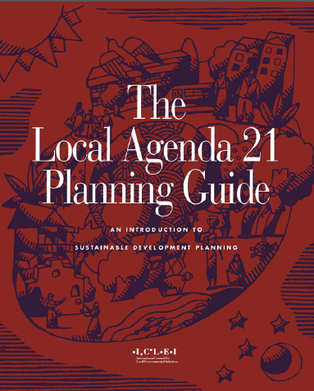
1990
Local Governments for Sustainability
ICLEI USA/ICLEI Global*
Foreword by Maurice Strong
http://web.idrc.ca/openebooks/448-2/
“The Local Agenda 21 Planning Guide has
been prepared to assist local governments
and their local partners to learn and
undertake the challenging task of
sustainable development planning.”
Akron
Cleveland
Alliance
Oberlin
Youngstown
(pay dues)
“The Guide offers tested and practical advice
on how local governments can implement the
United Nations‘ Agenda 21 action plan for
sustainable development and the related
United Nations’ Habitat Agenda.”
http://www.iclei.org/
* International Council on Local Environmental Initiatives

Slide 12
In 1992 the UN Conference of Environment and
Development was held in Rio de Janeiro.
The creation of “The Agenda for the 21st Century”
was the significant outcome of the conference.
It came to be known as Agenda 21.
It also paved the way for the 1997 Kyoto Treaty
on controlling greenhouse gas transmissions.
Maurice Strong was the Secretary General
(There were allegations that Strong was
involved in the oil for food scandal at the UN.)
President George H. W. Bush signed for the
United States

Slide 13
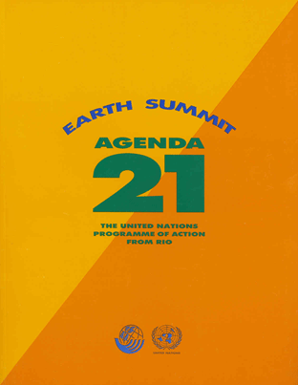
UN Conference on Environment and Development
“Current lifestyles and consumption
patterns of the affluent middle class –
involving high meat intake, the use of fossil
fuels, electrical appliances, home and
work-place air-conditioning, and suburban
housing – are not sustainable. “
1992
(Opening speech by Maurice Strong,
Secretary General)
Contributors included Sierra Club, Nature Conservancy,
World Resources Institute, ICLEI among others
http://www.un-documents.net/agenda21.htm

Slide 14
Agenda 21 consists of 40 chapters proscribing
ways to manage just about every facet of life.
It also proposes a significant transfer of
wealth, funding and other resources from
developed nations to undeveloped nations.
Remember the names Sierra Club, Nature
Conservancy and World Resources Institute.
They will show up later.

Slide 15
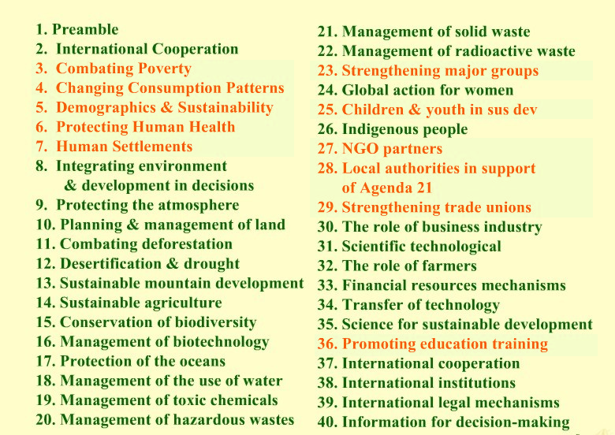
Earth Summit Rio
1992
http://www.un-documents.net/agenda21.htm

Slide 16
If there was any doubt that the United States
government had an interest in Agenda 21,
the following Congressional concurrent resolution in
September 1992 should put the doubt aside.
Agenda 21 is mentioned 11 times and
Sustainable Development 6 times.

Slide 17
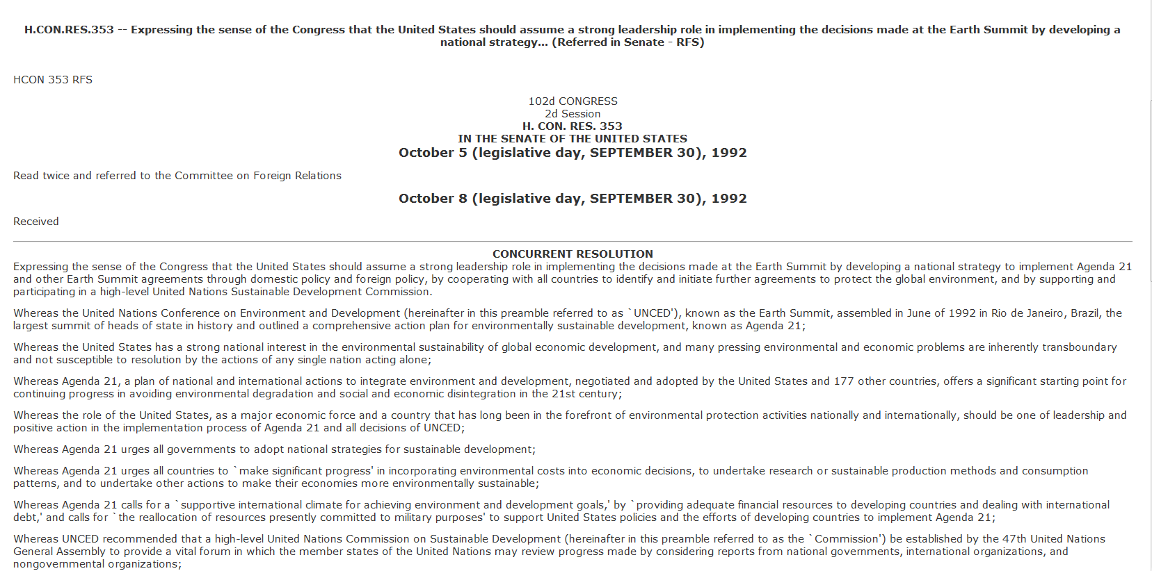
1992
“Expressing the sense of the Congress that the United States should
assume a strong leadership role in implementing the decisions made
at the Earth Summit by developing a national strategy to implement
Agenda 21 and other Earth Summit agreements….”
http://www.bill-wink.com/HR353.RFS.htm

Slide 18
Another actor with global influence is
The Club of Rome. In 1993, a report to
the organization concluded:
“The real enemy then is humanity itself.”

Slide 19
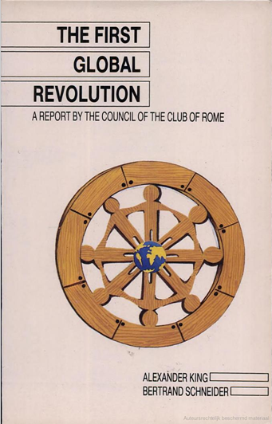
1993
“In searching for a common enemy against whom
we can unite, we came up with the idea that
pollution, the threat of global warming, water
shortages, famine and the like, would fit the bill.
In their totality and their interactions these
phenomena do constitute a common threat
which must be confronted by everyone together.
But in designating these dangers as the enemy, we fall into
the trap, which we have already warned readers about,
namely mistaking symptoms for causes. All these dangers
are caused by human intervention in natural processes, and
it is only through changed attitudes and behaviour that they
can be overcome. The real enemy then is humanity itself.”
http://archive.org/stream/TheFirstGlobalRevolution#page/n85/
mode/2up/search/global+warming

Slide 20
In 1995 the UN published their
Global Biodiversity Assessment
which included a list of activities
considered to be unsustainable.
Not much in our lives is left out.

Slide 21
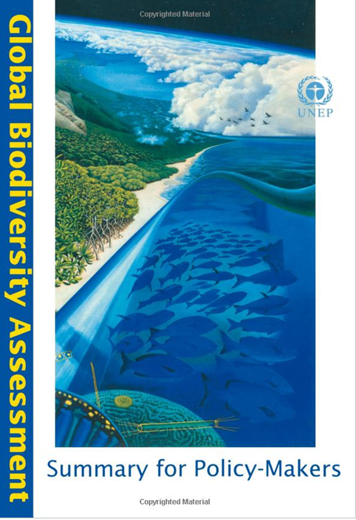
Deemed Unsustainable by the UN
1995
337 ski runs
350 grazing of livestock
351 disturbance of soil
350 large hoofed animals
350 compaction of soil
351 fencing of pastures
728 agriculture
728 modern farm systems
728 chemical fertilizers
728 herbicides
728 building materials
730 industrial activities
730 human-made caves
730 paved roads
730 railroads
730 floor & wall tiles
733 pastures, rangelands
733 fish ponds
733 aquaculture
733 technology improvements
733 farmlands
733 plantations
738 modern housing
738 timber harvesting
738 modern hunting
749 logging activities
728 fossil fuels
755 dams, reservoirs
755 straightening rivers
757 power line construction
763 inappropriate social structures
763 legal & institutional systems
766 Judeo-Christian-Islamic religions
767, 782 private property
771 population growth; family unit
774 habitat fragmentation
783 land that serves human needs
773 consumerism
774 sewers, pipelines
969 fisheries
970 golf courses
728 synthetic drugs
http://www.un.org/earthwatch/biodiversity/assessment.html

Slide 22
In 1993 President Clinton signed
Executive Order 12852 creating the
Presidents Council on Sustainable Development
The council included:
World Resources Institute (co-chair) #
The Nature Conservancy #
Sierra Club #
Most federal Agencies
# Helped write Agenda 21

Slide 23
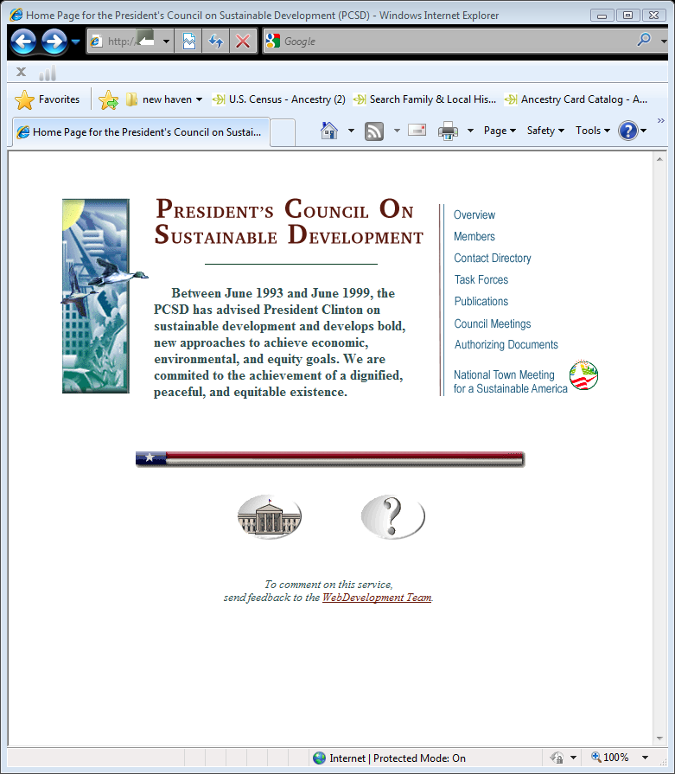
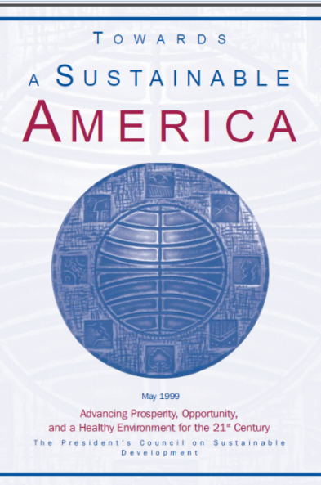
1993-1999
Established Executive Order 12852 June 29, 1993
Abolished Executive Order 23238 Sept. 30, 1999
The EO directed all agencies of the Federal Government to work with state and local community governments in a joint effort “reinvent” government using the guidelines outlined in Agenda 21.
Members of PCSD included World Resources Institute
(co-chair); Sierra Club; Nature Conservancy; EPA; HUD;
USDA; DOT; SBA; Commerce; NOAA; Energy; Education;
DOD; Interior & others.
http://clinton2.nara.gov/PCSD/

Slide 24
In 1998 the Federal Register included
a notice of funding available from the EPA
regarding Sustainable Development and
Agenda 21.

Slide 25
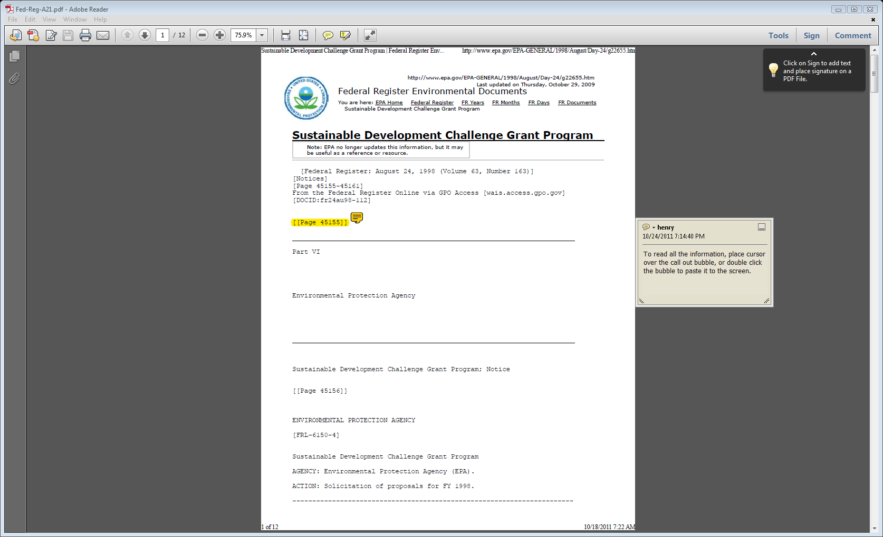
1998
“The Sustainable Development Challenge Grant Program is
also a step in implementing “Agenda 21, the Global Plan
of Action on Sustainable Development” signed by the
United States at the Earth Summit In Rio de Janeiro in 1992”
Federal Register August 24, 1998 Volume 63, Number 163 p 45155-45161

Slide 26
The state of Ohio doesn’t want to be left out.
In 2013 a central planning role was given to
The Ohio Lake Erie Commission.
They have the authority to recommend
model zoning ordinances, regulations
and guidance documents

Slide 27
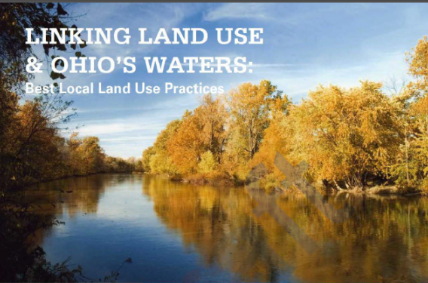
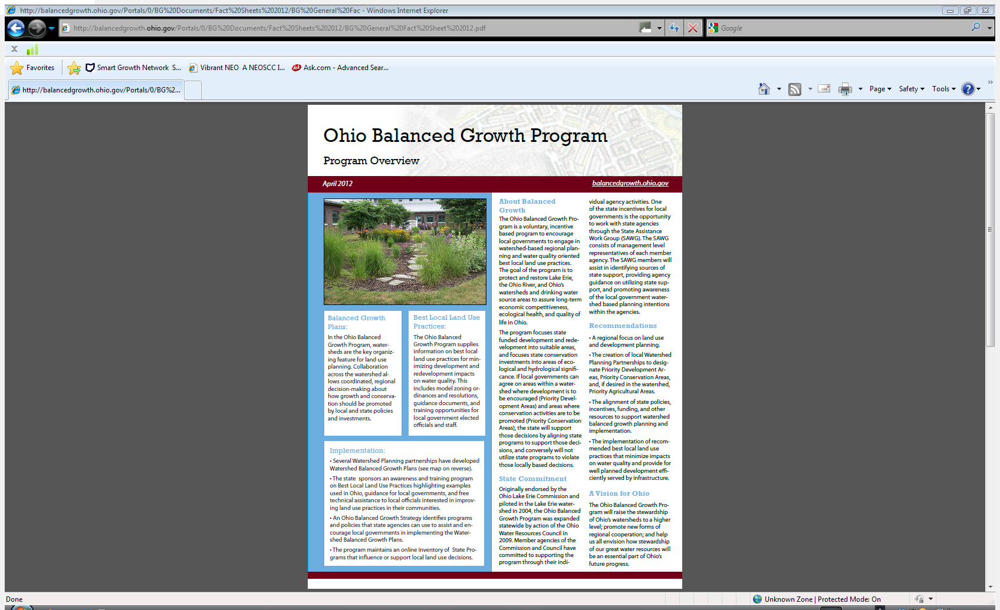
2013
In the Ohio Balanced Growth Program, watersheds are the key organizing feature for land use planning. Collaboration across the watershed allows coordinated, regional decision-making about how growth and conservation should be promoted by local and state policies and investments.
The Ohio Balanced Growth Program supplies information on best local land use practices for minimizing development and redevelopment impacts on water quality. This includes model zoning ordinances and resolutions, guidance documents, and training opportunities for local government elected officials and staff.
www.balancedgrowthohio.gov

Slide 28
Best Local Land Practices
“Voluntary incentive based”
Includes sample regulations and codes for:
Comprehensive Planning | Tree & Woodland Protection
Compact Development | Steep Slope Protection
Conservation Development | Agricultural Land Protection
Storm Water Management | Transfer of Development Rights
Stream, Floodplain, Wetland Mgt | Historic Protection
Source Water Protection | Scenic Protection
Natural Areas Management | Access Management
Brownfields Redevelopment
http://www.balancedgrowth.ohio.gov/BestLocalLandUsePractices/
BestLocalLandUsePractices2012.aspx

Slide 29
In 2009 the Partnership for
Sustainable Communities was established.
Funding was made available
through HUD, EPA & DOT.
Grants were awarded to encourage
implementation of regionalism and
promote regulations regarding
housing, land use, air & water quality,
transportation, the environment
and much more.

Slide 30
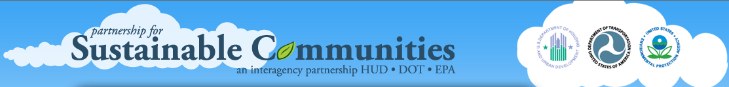
2009
Offer Sustainable Communities Planning Grants
Enable multi-jurisdictional partnerships to establish
policies, codes, tools & critical capital investments
needed to achieve sustainable and
inclusive development.
Supports capacity-building and a clearinghouse
designed to support grant recipients
provides funding for a joint HUD-DOT-EPA research
effort designed to advance transportation and
housing linkages
http://www.sustainablecommunities.gov/#

Slide 31
In 2010 the Northeast Ohio Areawide
Coordinating Agency (NOACA) acted as
fiscal agent for the
Northeast Ohio Sustainable Communities Consortium.
They were awarded $4.25 million and more than
$2 million in in-kind donations from
local governments, foundations and others.
Their objective is to promote regionalism
across 12 counties in northeast Ohio.

Slide 32
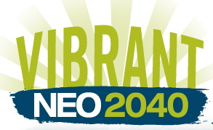
Northeast Ohio was awarded a $4.25 million
federal grant from the US Department
of Housing and Urban Development
to fund the development of a
regional sustainability plan.
2010
Northeast Ohio Sustainable Communities Consortium
(NEOSCC) was established in January 2011. The NEOSCC will
develop a coordinated and integrated approach to planning
efforts for land use, transportation, economic and workforce
development, and infrastructure investments for Ashtabula,
Cuyahoga, Geauga, Lake, Lorain, Mahoning, Medina,
Portage, Summit, Stark, Trumbull and Wayne counties.
http://vibrantneo.org/

Slide 33
You are encouraged to do your own homework.
Research the internet, YouTube, government
documents. See also www.davidfrost.org
So, lets see if we can connect the dots….

Slide 34





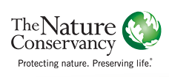
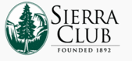


Your Towns
Comprehensive
Plan?

Slide 35
What parts of our lives are to be
managed by “sustainability”?

Slide 36
Environmental
quality
Education
Social health
Food
policy
Energy
Planning &
land use
Air Quality
Sustainability
Greening
Development
Water &
liquid waste
Transportation
Solid waste
Municipal
management
& finance
Greening
economic
development
Corporate
performance

Slide 37
Most of us support principles of wise management
of our resources, clean air and water, care of the
environment in general.
What is disturbing is the heavily funded and
widely promoted new governance leading
to regionalism overseen by unelected bureaucrats
and irresponsible elected officials.
We will lose our ability to hold elected
officials accountable. Our task is
to be diligent, informed and make certain
our elected officials and the public are
aware of efforts to impose regionalism in Ohio.

